Slide 1

Electrolysis and Material Storage of Hydrogen Gas
Notes:
Dylan
Welcome and thank you for coming to embry-riddle hydrogens design concept review. Our project focuses on hydrogen technology, specifically electrolysis and material storage of hydrogen

Slide 2







Team Members
Dylan Astrup
Detail Team Lead
Hannah Spiller
Lead Material Storage Engineer
Grant Carrabine
Lead Electrolysis Engineer
Tesla Alford III
Lead Extraction Engineer
Titan Berson
Lead Interface Engineer
Jacob Wolf
Lead Piping Engineer
Notes:
Dylan

Slide 3







Agenda
Problem
System Requirements
Verification Tests
Conclusion
System Description
Limiting Factors
Future Suggestions
Notes:
Dylan

Slide 4
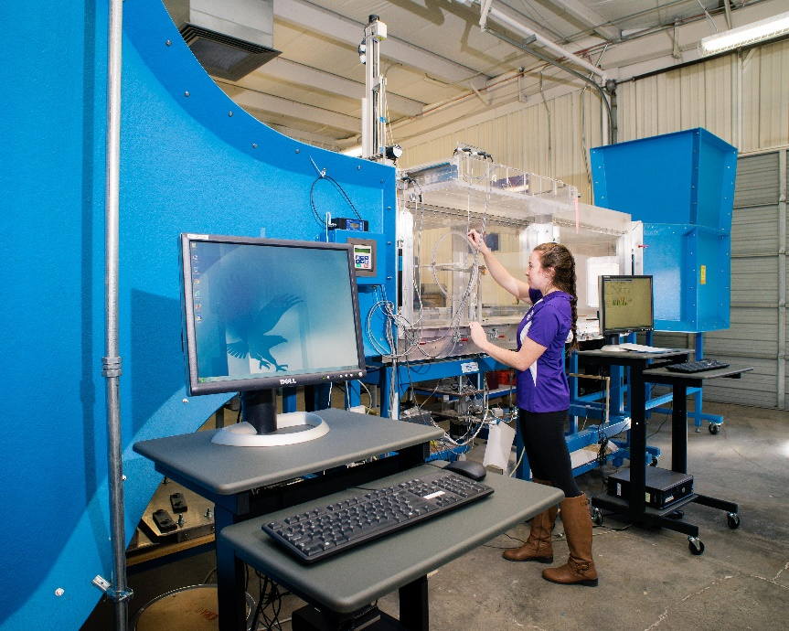
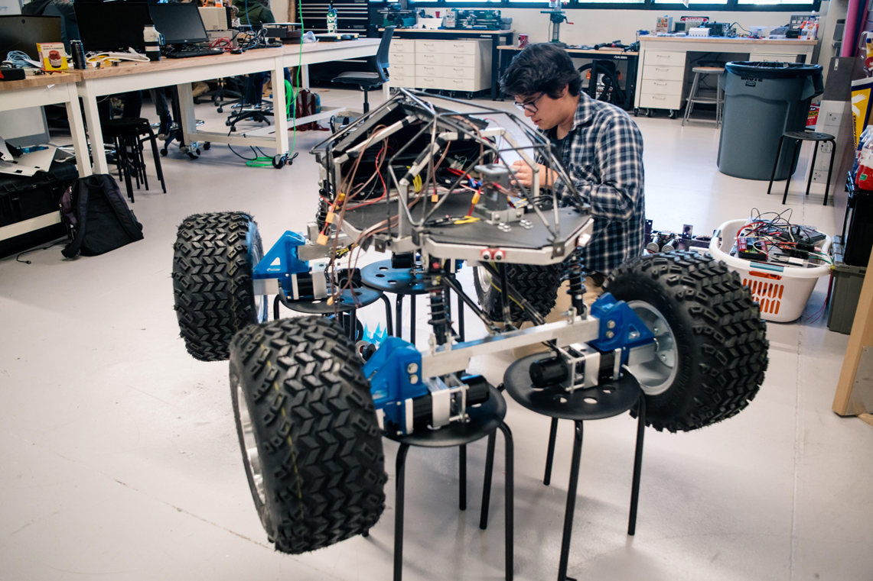
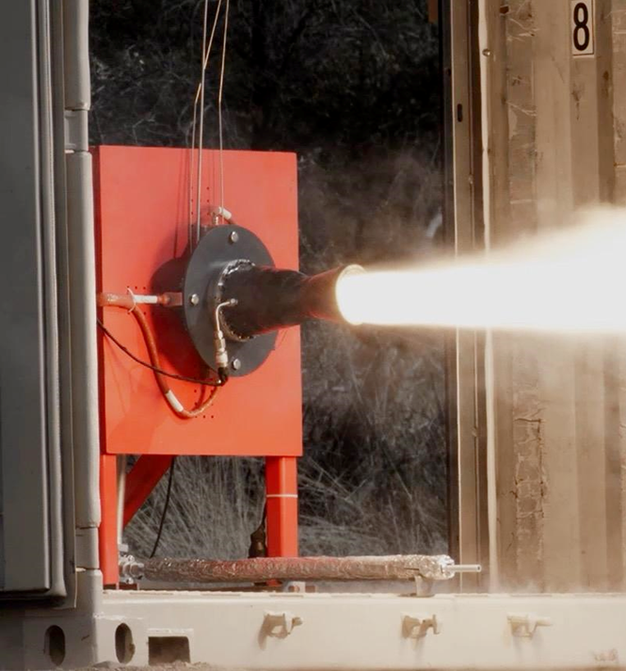
What Embry-Riddle Has
Wind Tunnel
Robotics Lab
Propulsion Lab
Notes:
Jacob
Nancy and tracy doryland wind tunnel

Slide 5
What Embry-Riddle Needs
Energy Labs
Create Interest in the Energy Track
Viewable Demonstrations
Notes:
Jacob

Slide 6
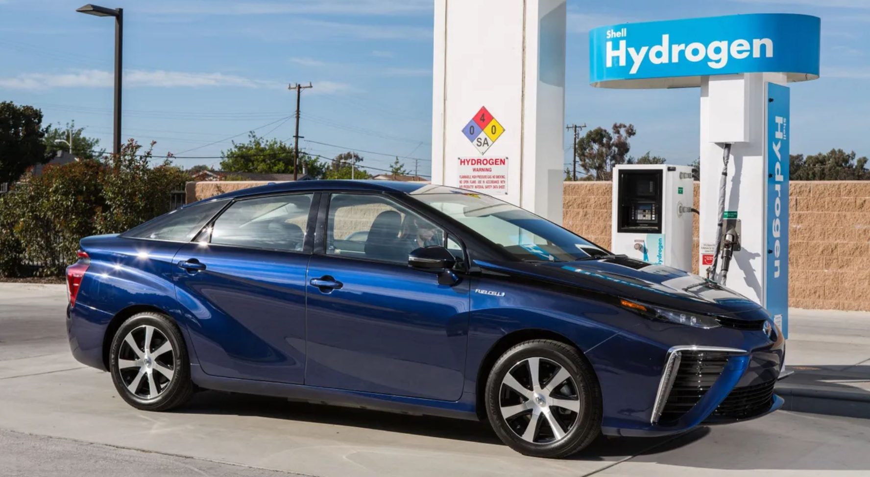
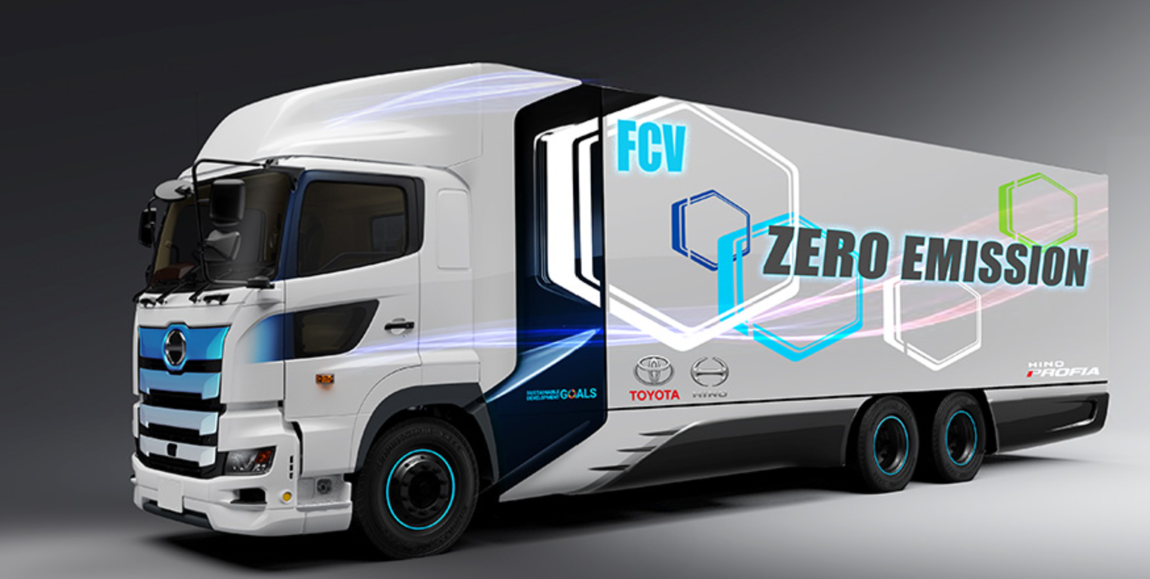

Hydrogen Storage Applications
Personal Vehicles
Commercial Vehicles
Aircraft
Storing hydrogen at high pressures and cryogenic temperatures is dangerous and heavy.
Notes:
Hannah: Using Hydrogen as a fuel is a potential clean energy solution across many applications, including transportation. Toyota is developing personal vehicles and commercial vehicles that use hydrogen as fuel. A potential problem with hydrogen is that it is currently stored at high pressures or cryogenic temperatures. This is extremely heavy and is potentially dangerous.

Slide 7

Generate and Store Hydrogen
ERH2’s purpose is to create an energy demonstrator to generate and store hydrogen.
Notes:
Dylan – our purpose is… in order to create facilities to take advantage of the DOE funding FUEL CELL

Slide 8
System Requirements
Produce Hydrogen
1.1.1 The system must produce enough hydrogen to get the fuel cell to steady state and then run for 10 minutes at 1 watt.
Store Hydrogen
1.2 The storage method must run the fuel cell for a minimum of 5 minutes.
1.2.1 The system must measure the amount of hydrogen stored.
Run Fuel Cell
1.4 The system must interface with the Embry-Riddle fuel cell.
1.4.1 The system output must be a ¼” PTFE tube.
1.1.2 The system must be able to determine the rate of hydrogen gas produced.
Notes:
Hannah- In fulfilling our purpose we have created requirements.

Slide 9

System Description
Notes:
Tesla

Slide 10
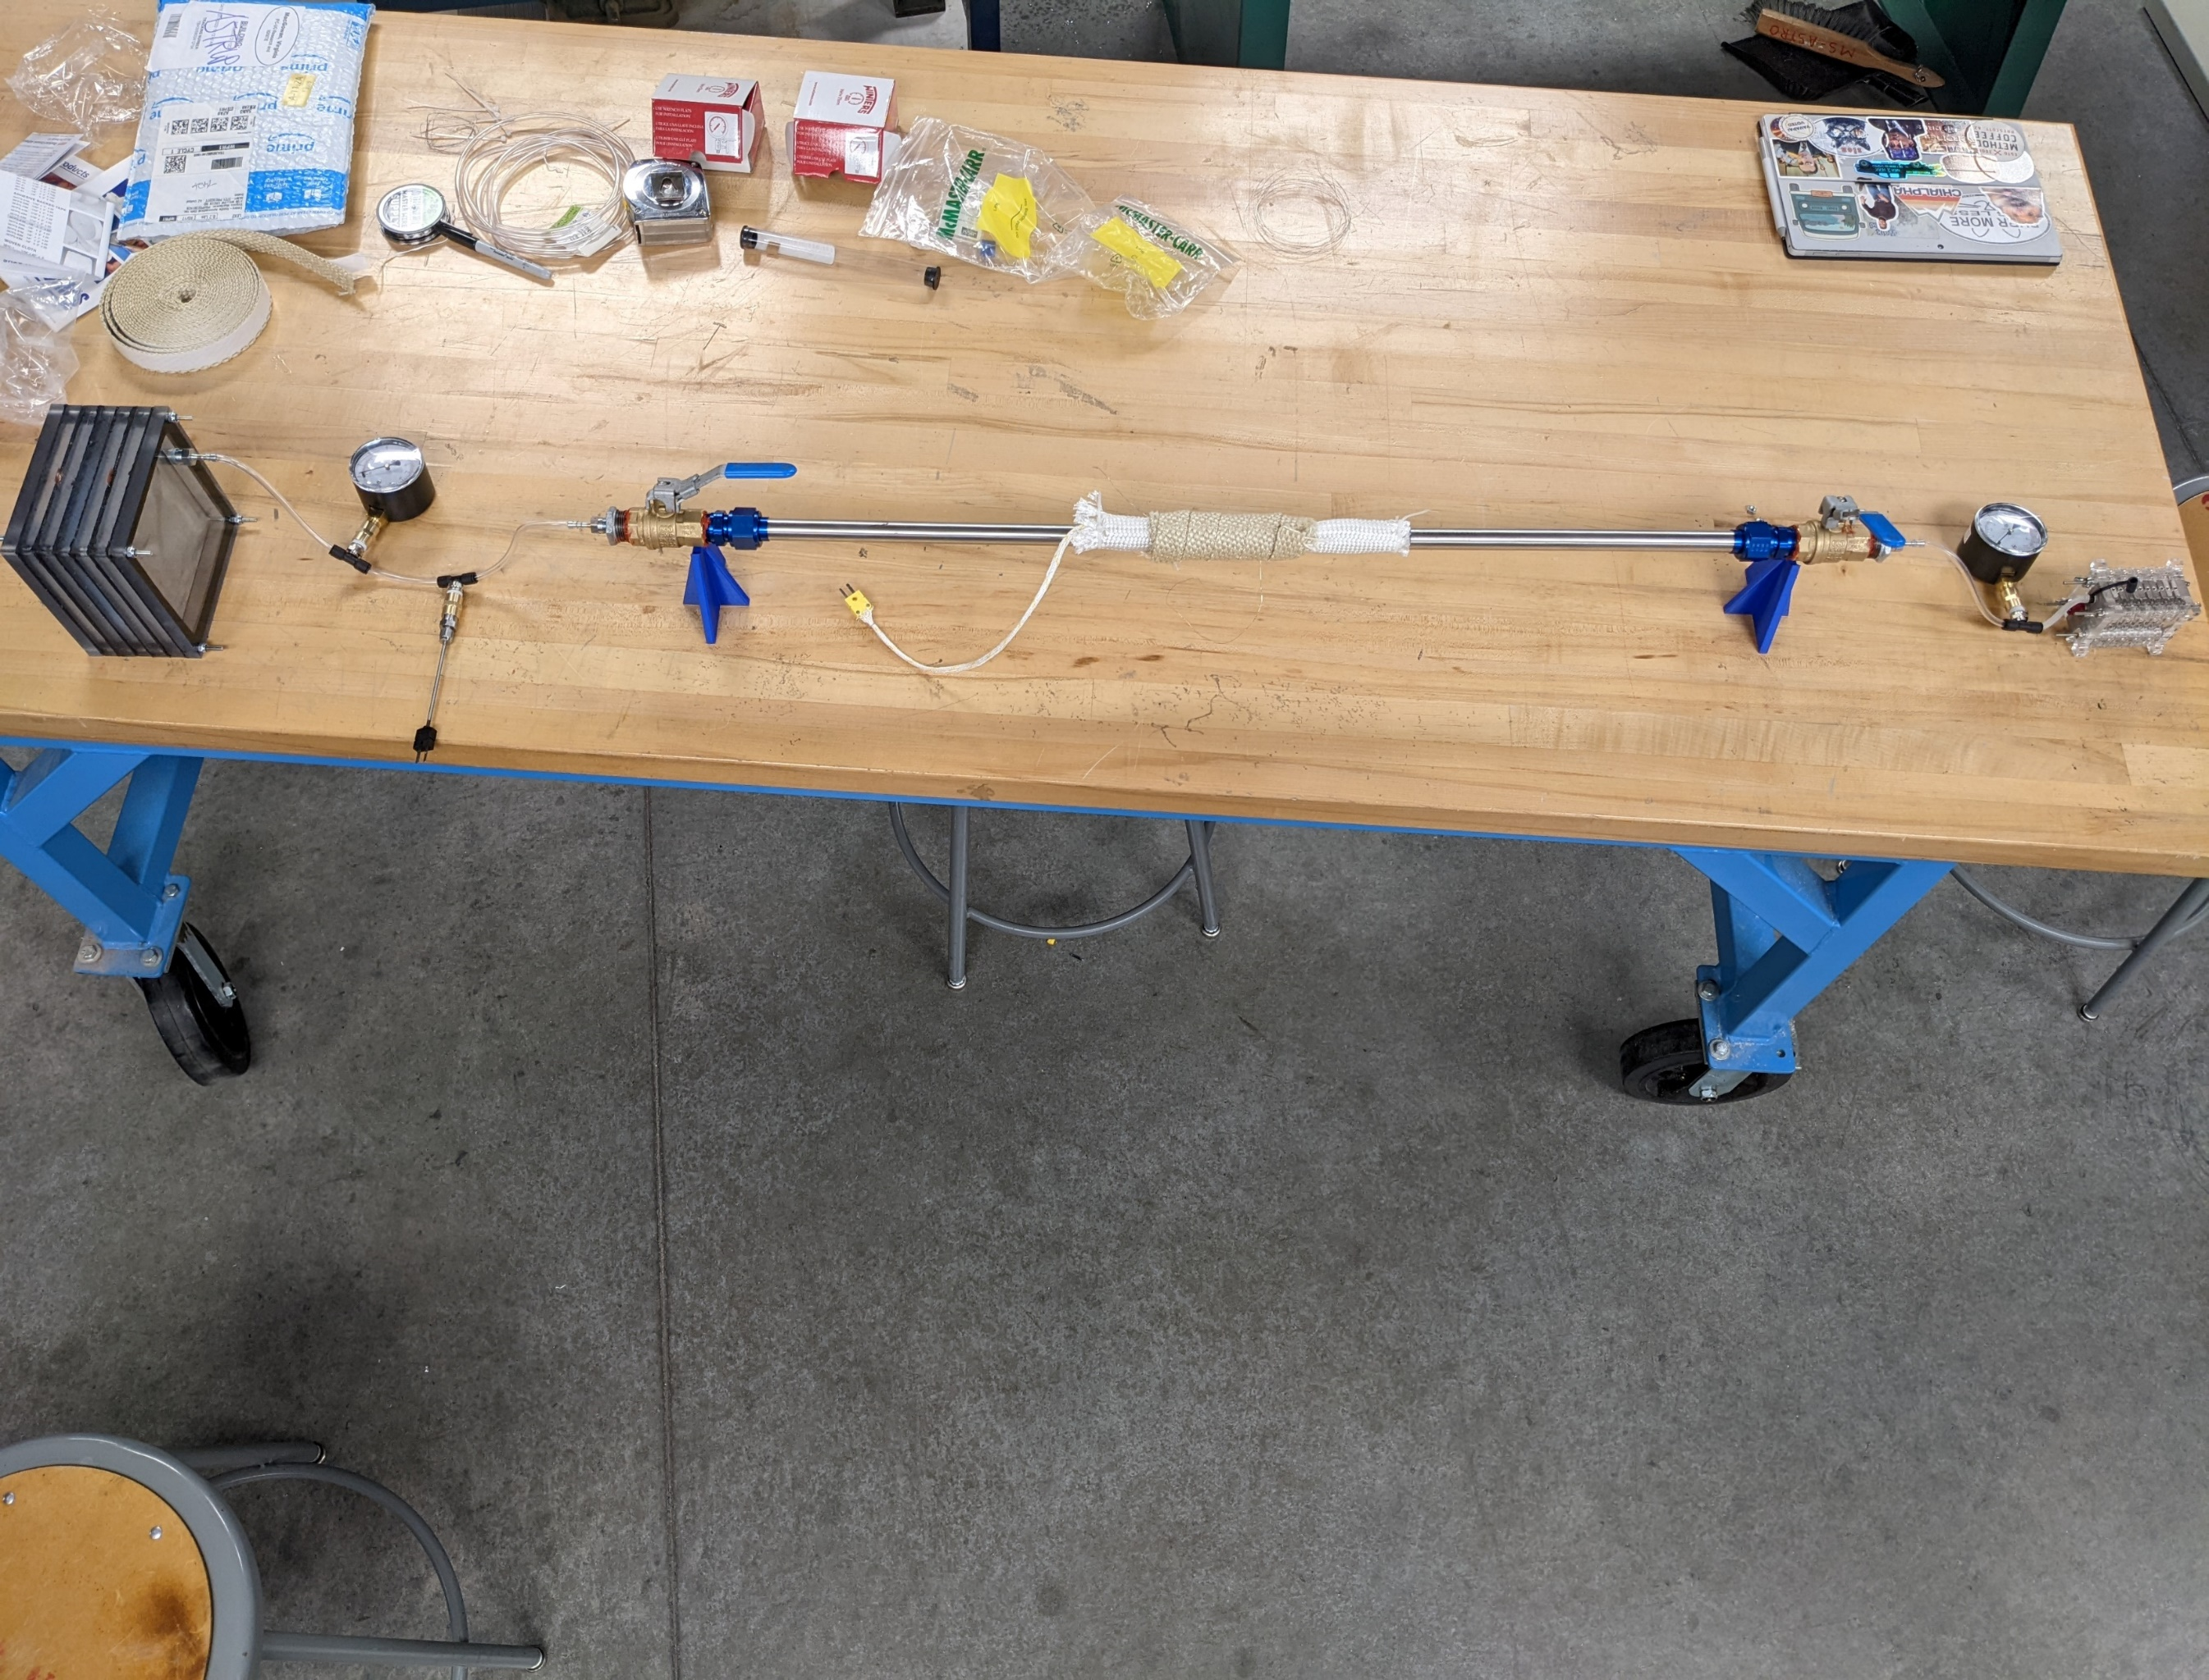
ERH2 System Overview
Pressure Gauge
Electrolyzer
Valves
Fuel Cell
Stainless Steel Pipe
Storage & Extraction
Thermocouples
Notes:
Tesla

Slide 11
ERH2 System Overview
Notes:
Tesla

Slide 12

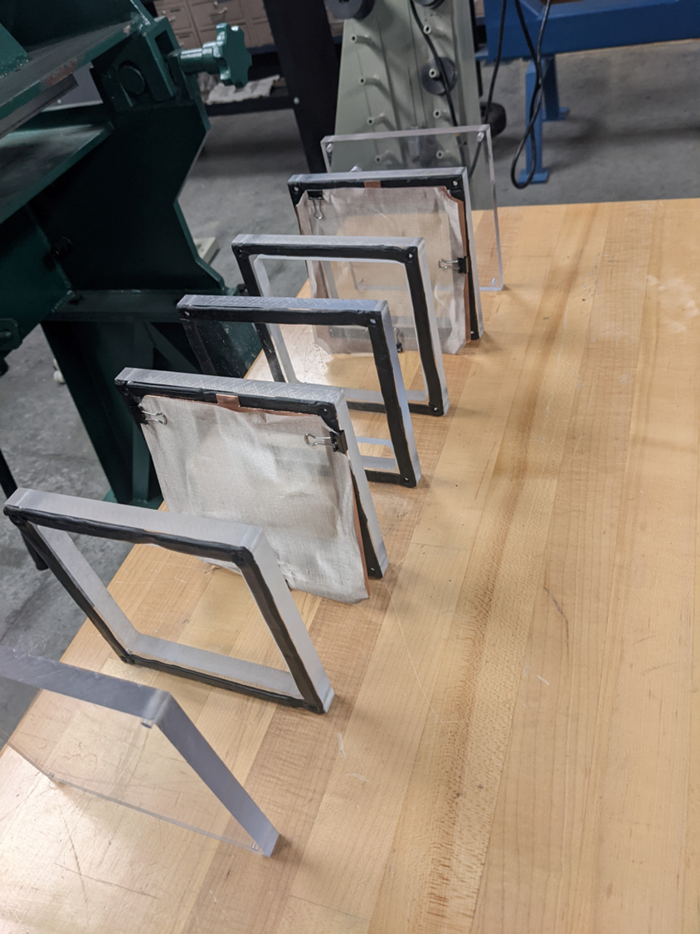
Electrolyzer Exploded View
Copper Bus
Nickle Mesh
Rubber Gasket
Polycarbonate Spacer
Notes:
Grant
More explanation
Describe polycarbonate layers

Slide 13
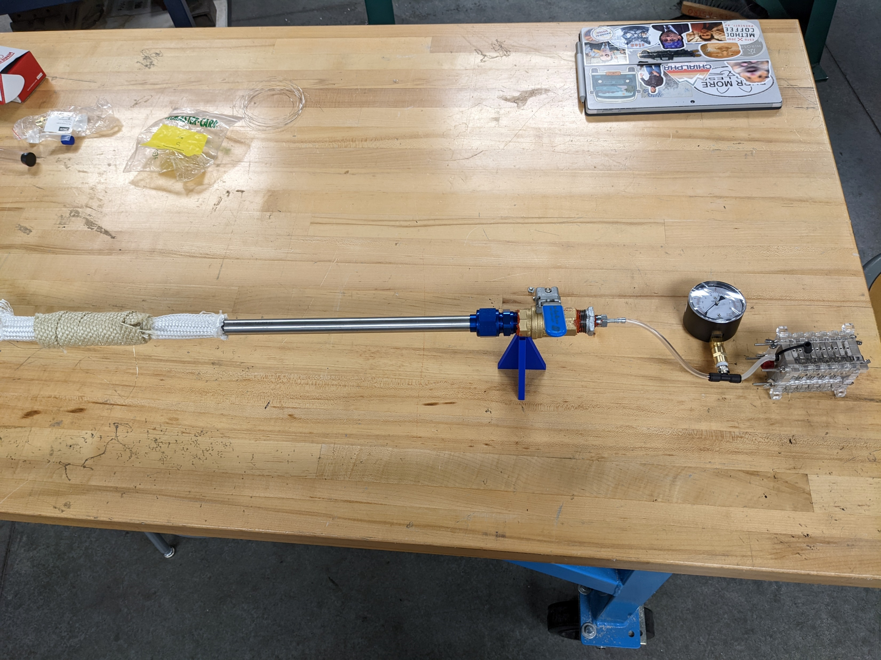

System Interfaces – Tee Fittings
Pressure Gauge
J-Type Thermocouple
¼ NPT Female to ¼ NPT Female
¼ OD Compression Tee to ¼ NPT
Notes:
Titan
Show where we are getting it from

Slide 14
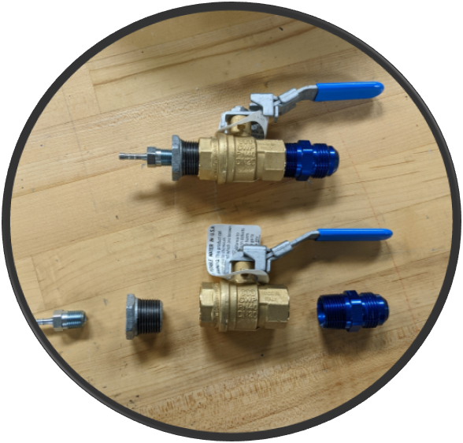
System Interfaces – Valve Assembly
¾ NPT Brass Ball Valve
Barbed Fitting
¾ NPT to AN Flare Adaptor
¼ to ¾ NPT Reducer
Notes:
Titan
Show where we are getting it from

Slide 15
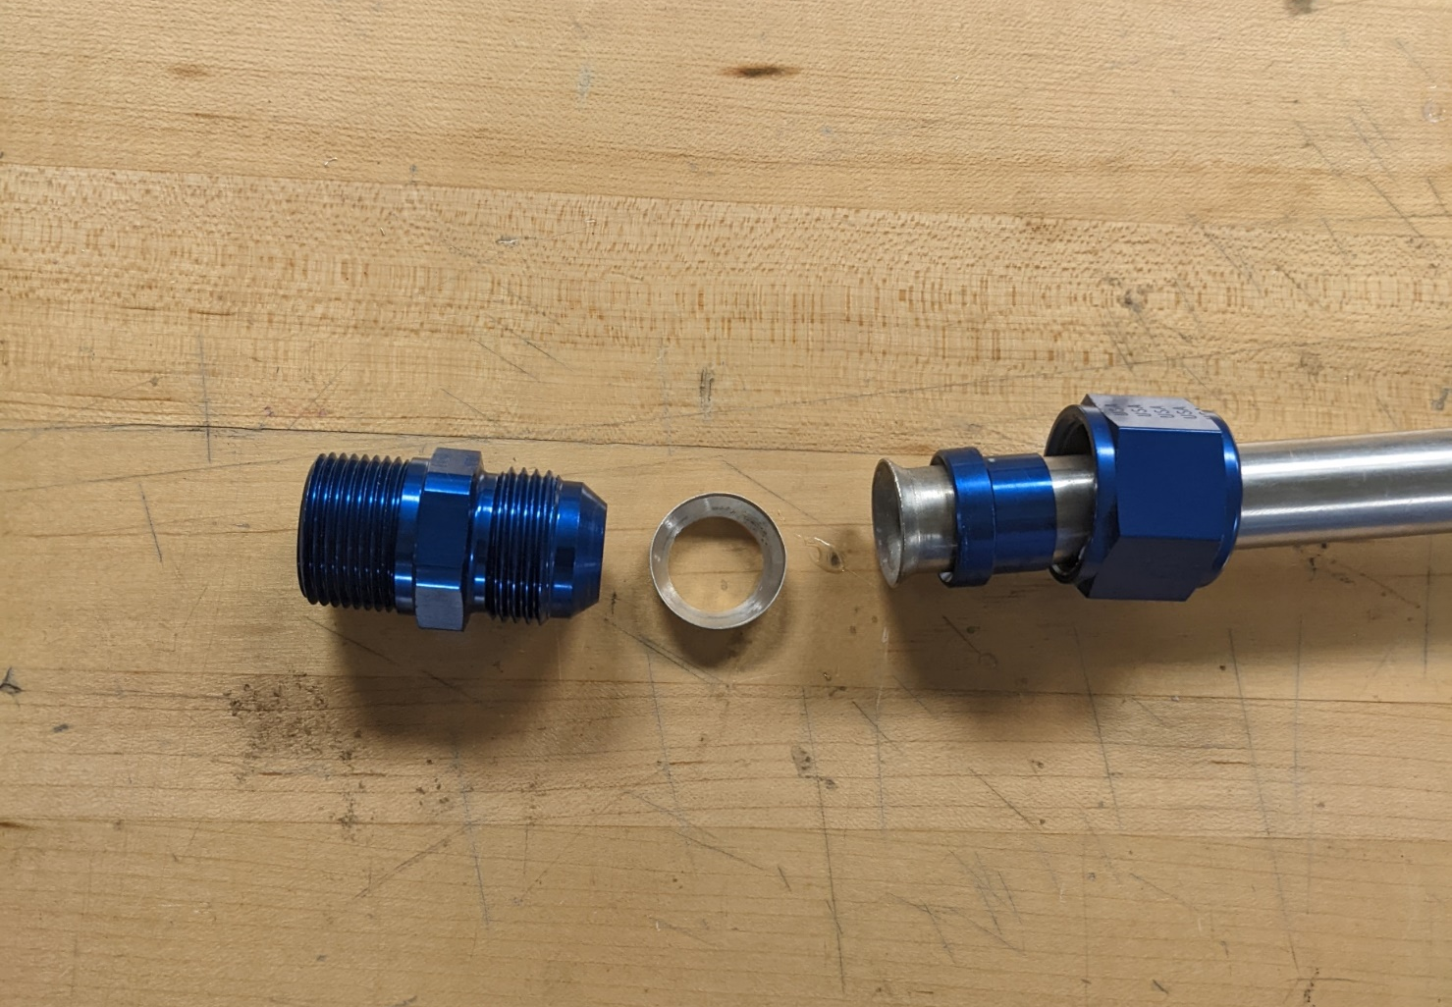
System Interfaces – Pipe Assembly
¾ AN Flare Nut
¾ NPT to AN Flare Adaptor
¾ AN Flare Sleeve
¾ Steel AN Flare Washer
Notes:
Titan
Show where we are getting it from

Slide 16
System Interfaces – Pipe Assembly
¾ AN Flare Nut
¾ NPT to AN Flare Adaptor
¾ AN Flare Sleeve
¾ Steel AN Flare Washer
Notes:
Titan
Show where we are getting it from

Slide 17

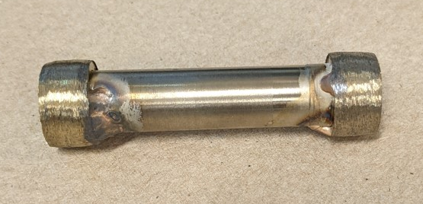
Material Storage
1 Micron Mesh
Hollow Stainless-Steel Capsule
Lithium-Doped Graphitic Carbon Nitride
Notes:
Hannah- Inserted into the pipe is the material storage capsule. This capsule is a hollow steel tube with a 1 micron mesh on the ends to allow hydrogen to flow but not allow water into the material. The storage material we used is LiCN.

Slide 18
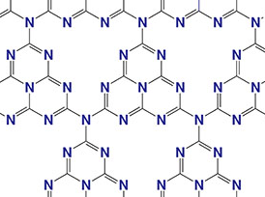


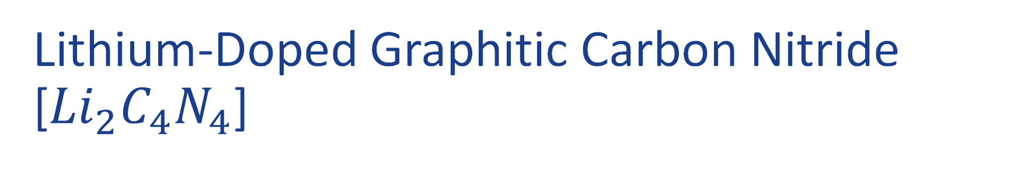





Lithium-Doped Graphitic Carbon Nitride [${Li}_{2}C_{4}N_{4}$]
Nitrogen Covalent Bonds
$${ H}_{2}$$
$${ H}_{2}$$
$${ H}_{2}$$
$${ H}_{2}$$
$${Li}_{2}$$
$${Li}_{2}$$
Lithium Atoms
$${ H}_{2}$$
$${ H}_{2}$$
$${ H}_{2}$$
$${ H}_{2}$$
Hydrogen Molecules
$${Li}_{2}$$
$${ H}_{2}$$
Graphitic Carbon Nitride
(Molecular Level)
300°C will break the bonds to allow the hydrogen to escape.
Notes:
Hannah
This is because the porous structures allow the hydrogen into interior of the nanotubes and pore edges containing double bonded nitrogen provide the active sites for adsorption of hydrogen either physically or chemically.

Slide 19
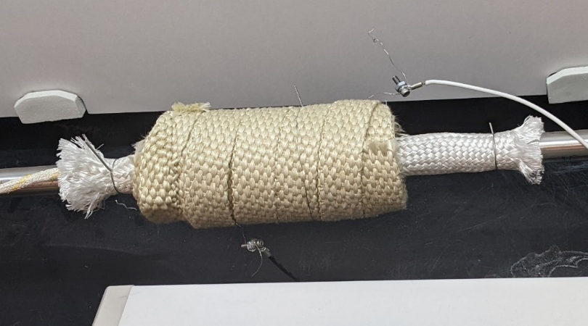
Extraction Zone
Nichrome Wire Lead
Electrical Insulation
Thermal Insulation
Notes:
Tesla

Slide 20

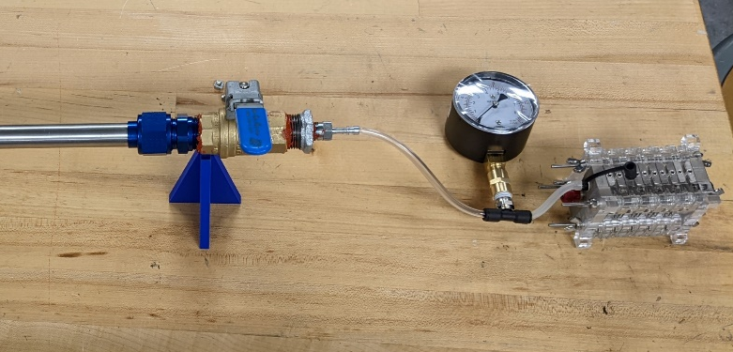
Fuel Cell Integration
Requirement 1.4
“The system must interface with the Embry-Riddle fuel cell.”
Requirement 1.4.1
“The system output must be a ¼” PTFE tube.”
Fuel Cell
¼” PTFE
Notes:
Titan

Slide 21
Budget
Total: $1221.04
$78.96 under budget
Notes:
Dylan

Slide 22
Budget
Total: $1495.07
$195.07 over budget
Notes:
Dylan

Slide 23






Concept of Operations
Weigh material storage capsule
Turn on electrolysis and flush pipe until light turns on
Close exit valve to begin loading material storage
Run electrolysis until pressure gauge reads maximum pressure
Attach valve assembly onto pipe
Load capsule into pipe with rod
Notes:
Dylan

Slide 24





Concept of Operations
Once at 300°C, slowly open exit valve to power fuel cell
Reinsert capsule into pipe using loading rod
Turn on electrolysis and flush pipe until light turns on
Let fuel cell light turn off, close both valves and turn on heating element
Turn off electrolysis, disconnect pipe from valve, remove and weigh the capsule
Notes:
Dylan

Slide 25
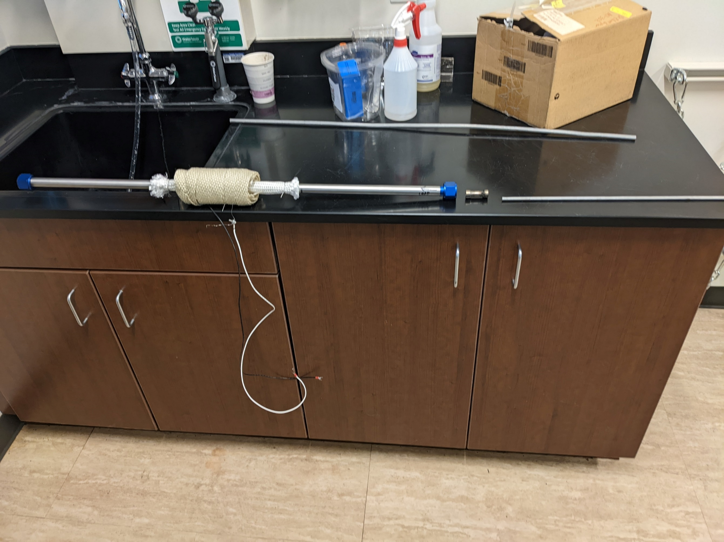
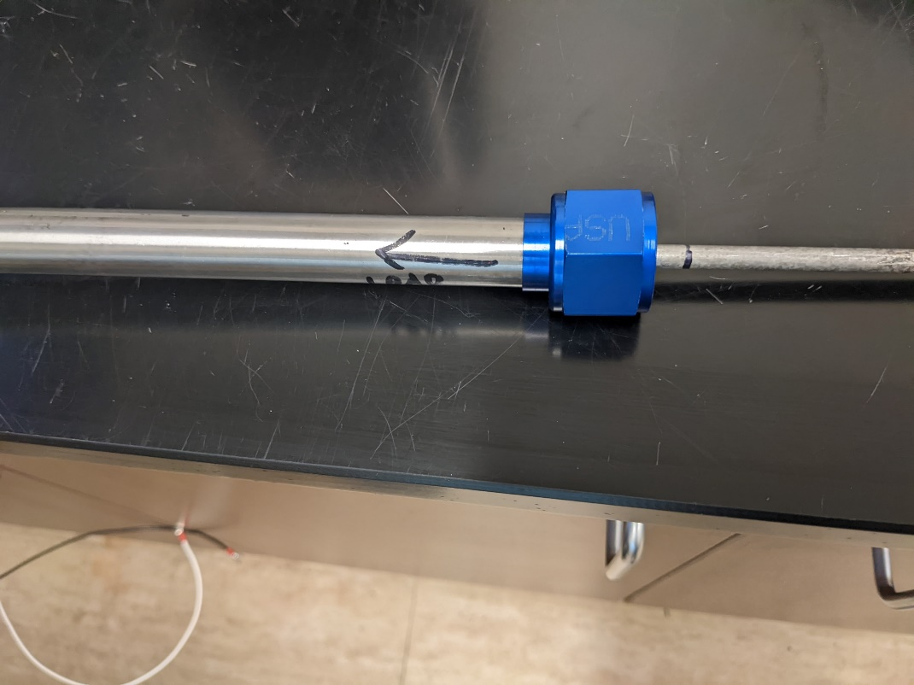
Concept of Operations
Notes:
Dylan

Slide 26
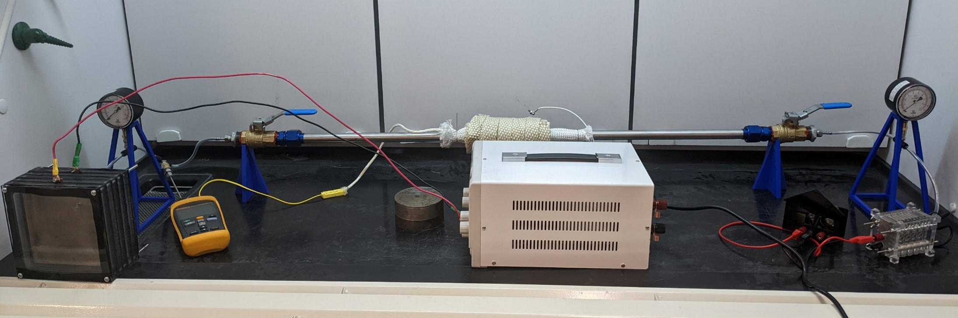
Concept of Operations
Step 3: Reattach interfaces, ensure all valves are open.
Step 4: Turn on the electrolyzer and run until the fuel cell light turns on.
Notes:
Dylan

Slide 27
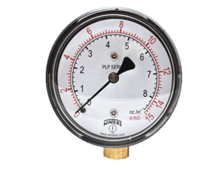
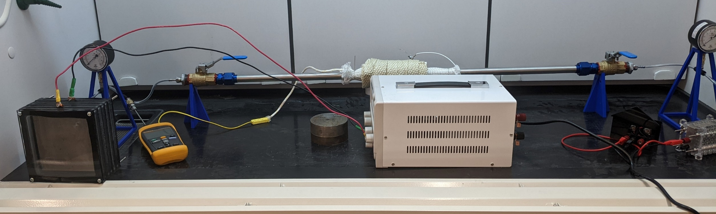
Concept of Operations
Notes:
Dylan

Slide 28
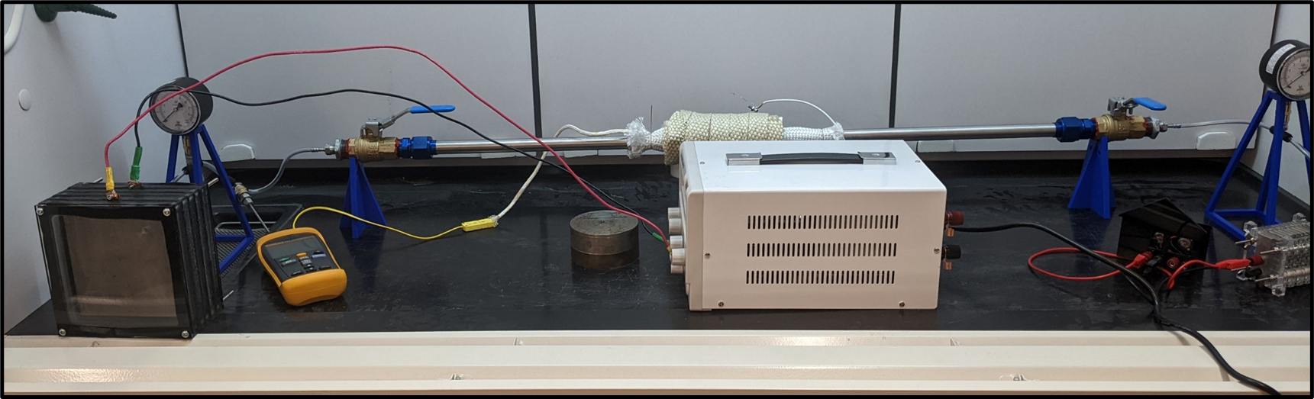
Closed Valve

Slide 29
Concept of Operations
Step 7: Turn off electrolyzer, disconnect pipe from valve, remove capsule, and weigh again.
Notes:
Dylan

Slide 30

Concept of Operations
Step 8: Reload capsule into pipe.
Step 9: Run another flush.
Notes:
Grant

Slide 31
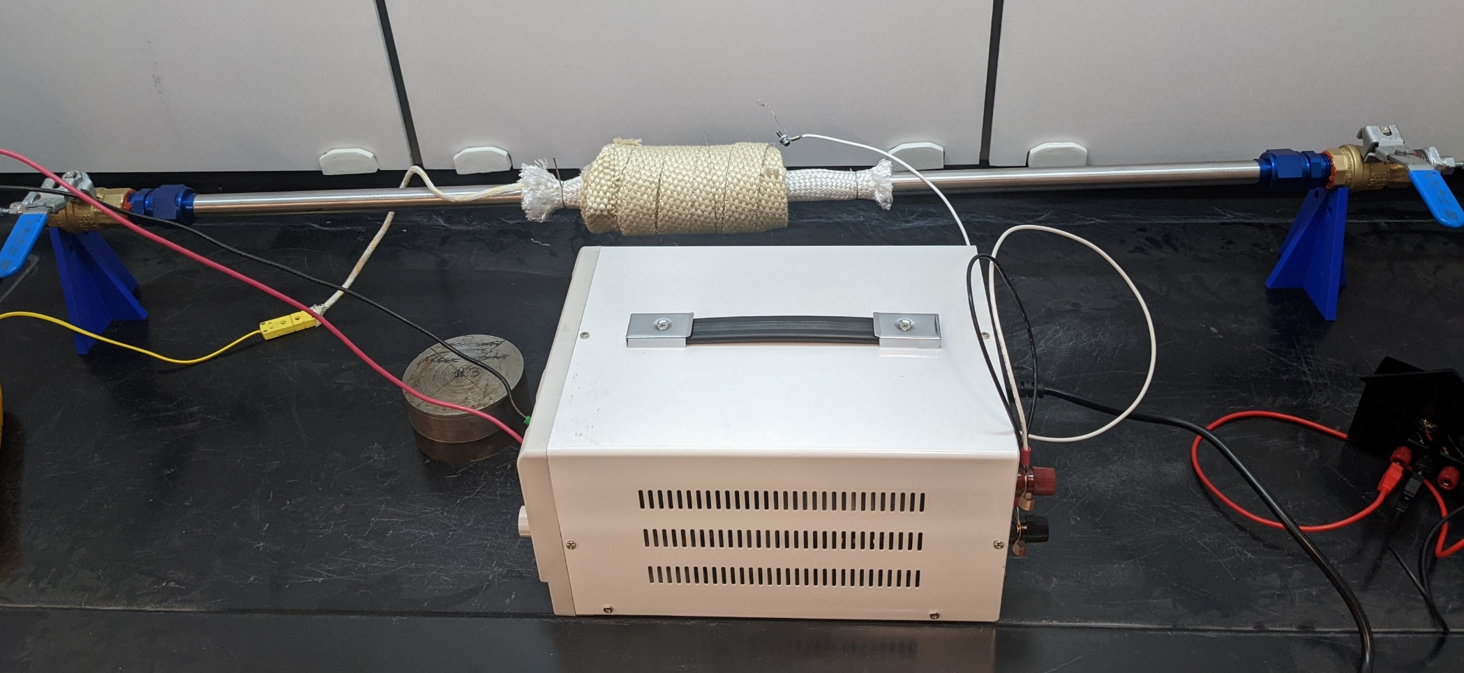
Concept of Operations
Step 10: Close both valves and turn on the heating element.
Notes:
Grant
Mention heat to 300C

Slide 32
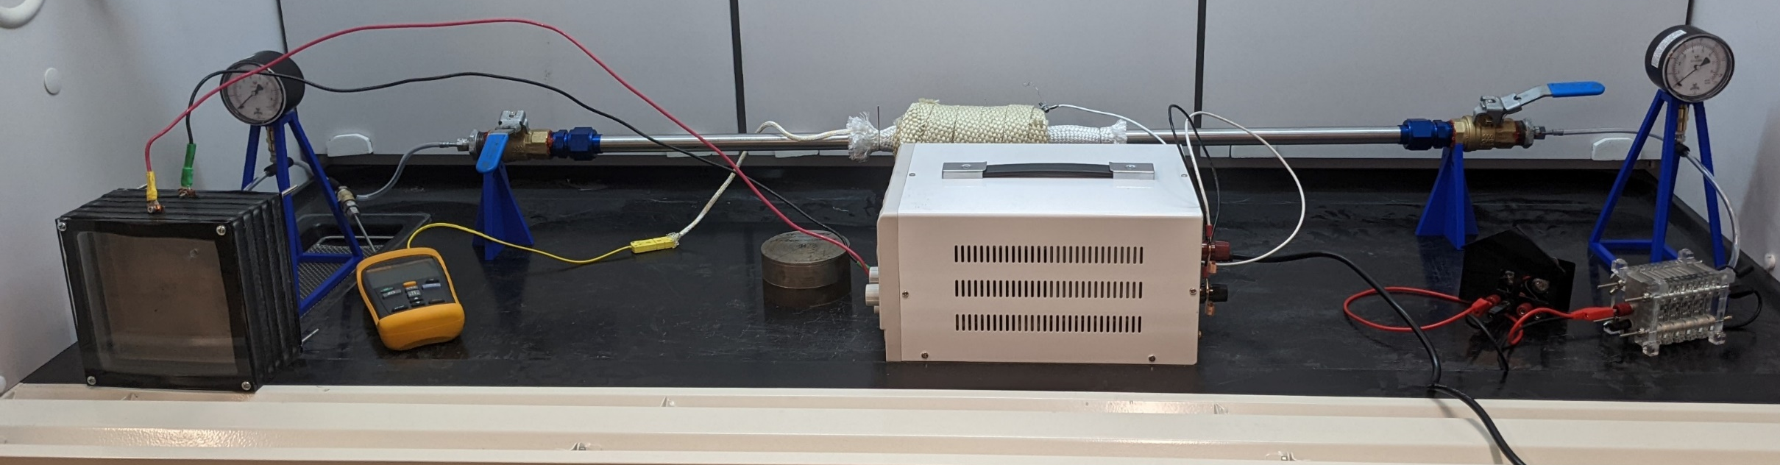
Concept of Operations
Step 11: Once the capsule reaches 300°C, slowly open the valve to the fuel cell. Start a timer to measure how long the fuel cell light stays on.
Notes:
Grant

Slide 33
Verification Tests
Notes:
GRant

Slide 34
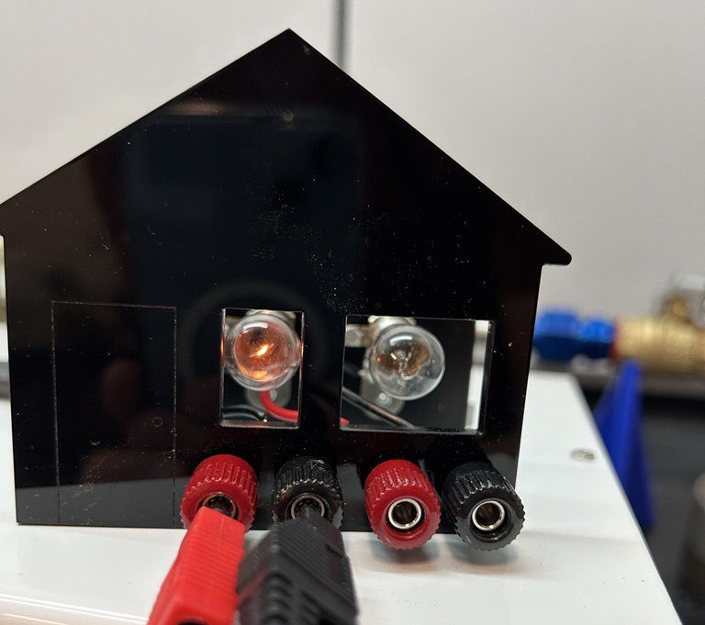
Production Rate
Requirement 1.1.1
“The system must produce enough hydrogen to get the fuel cell to steady state and then run for 10 minutes at 1 watt.”
Notes:
Grant

Slide 35
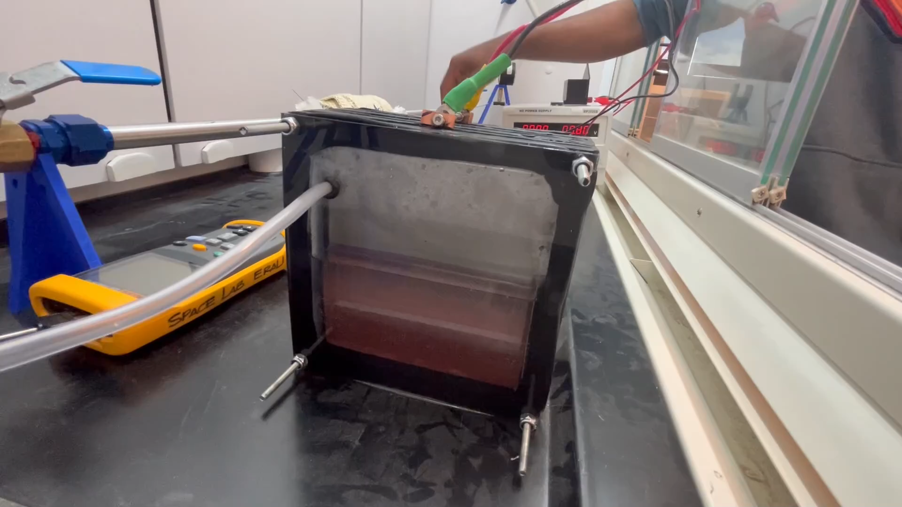
0.5x

Slide 36
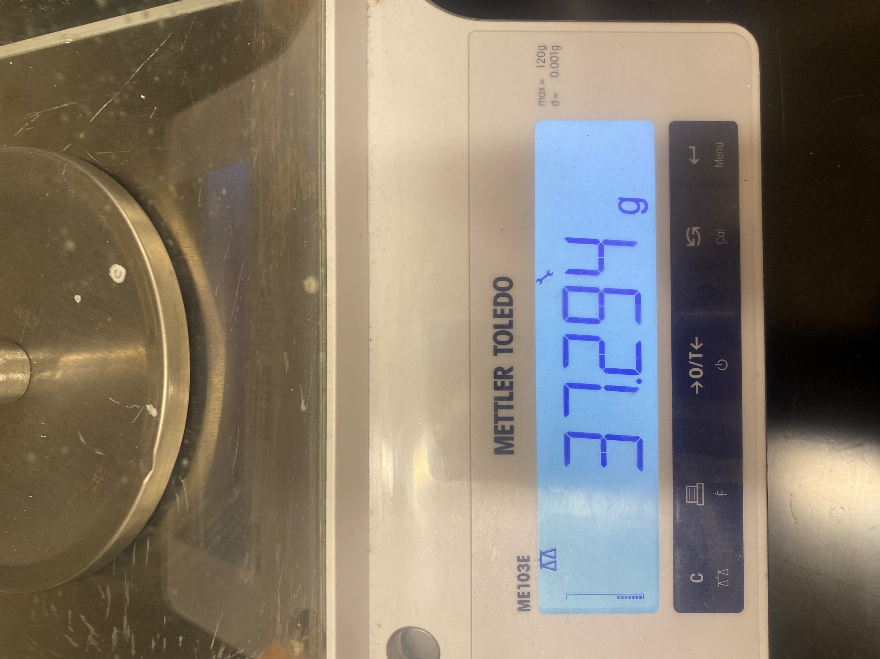
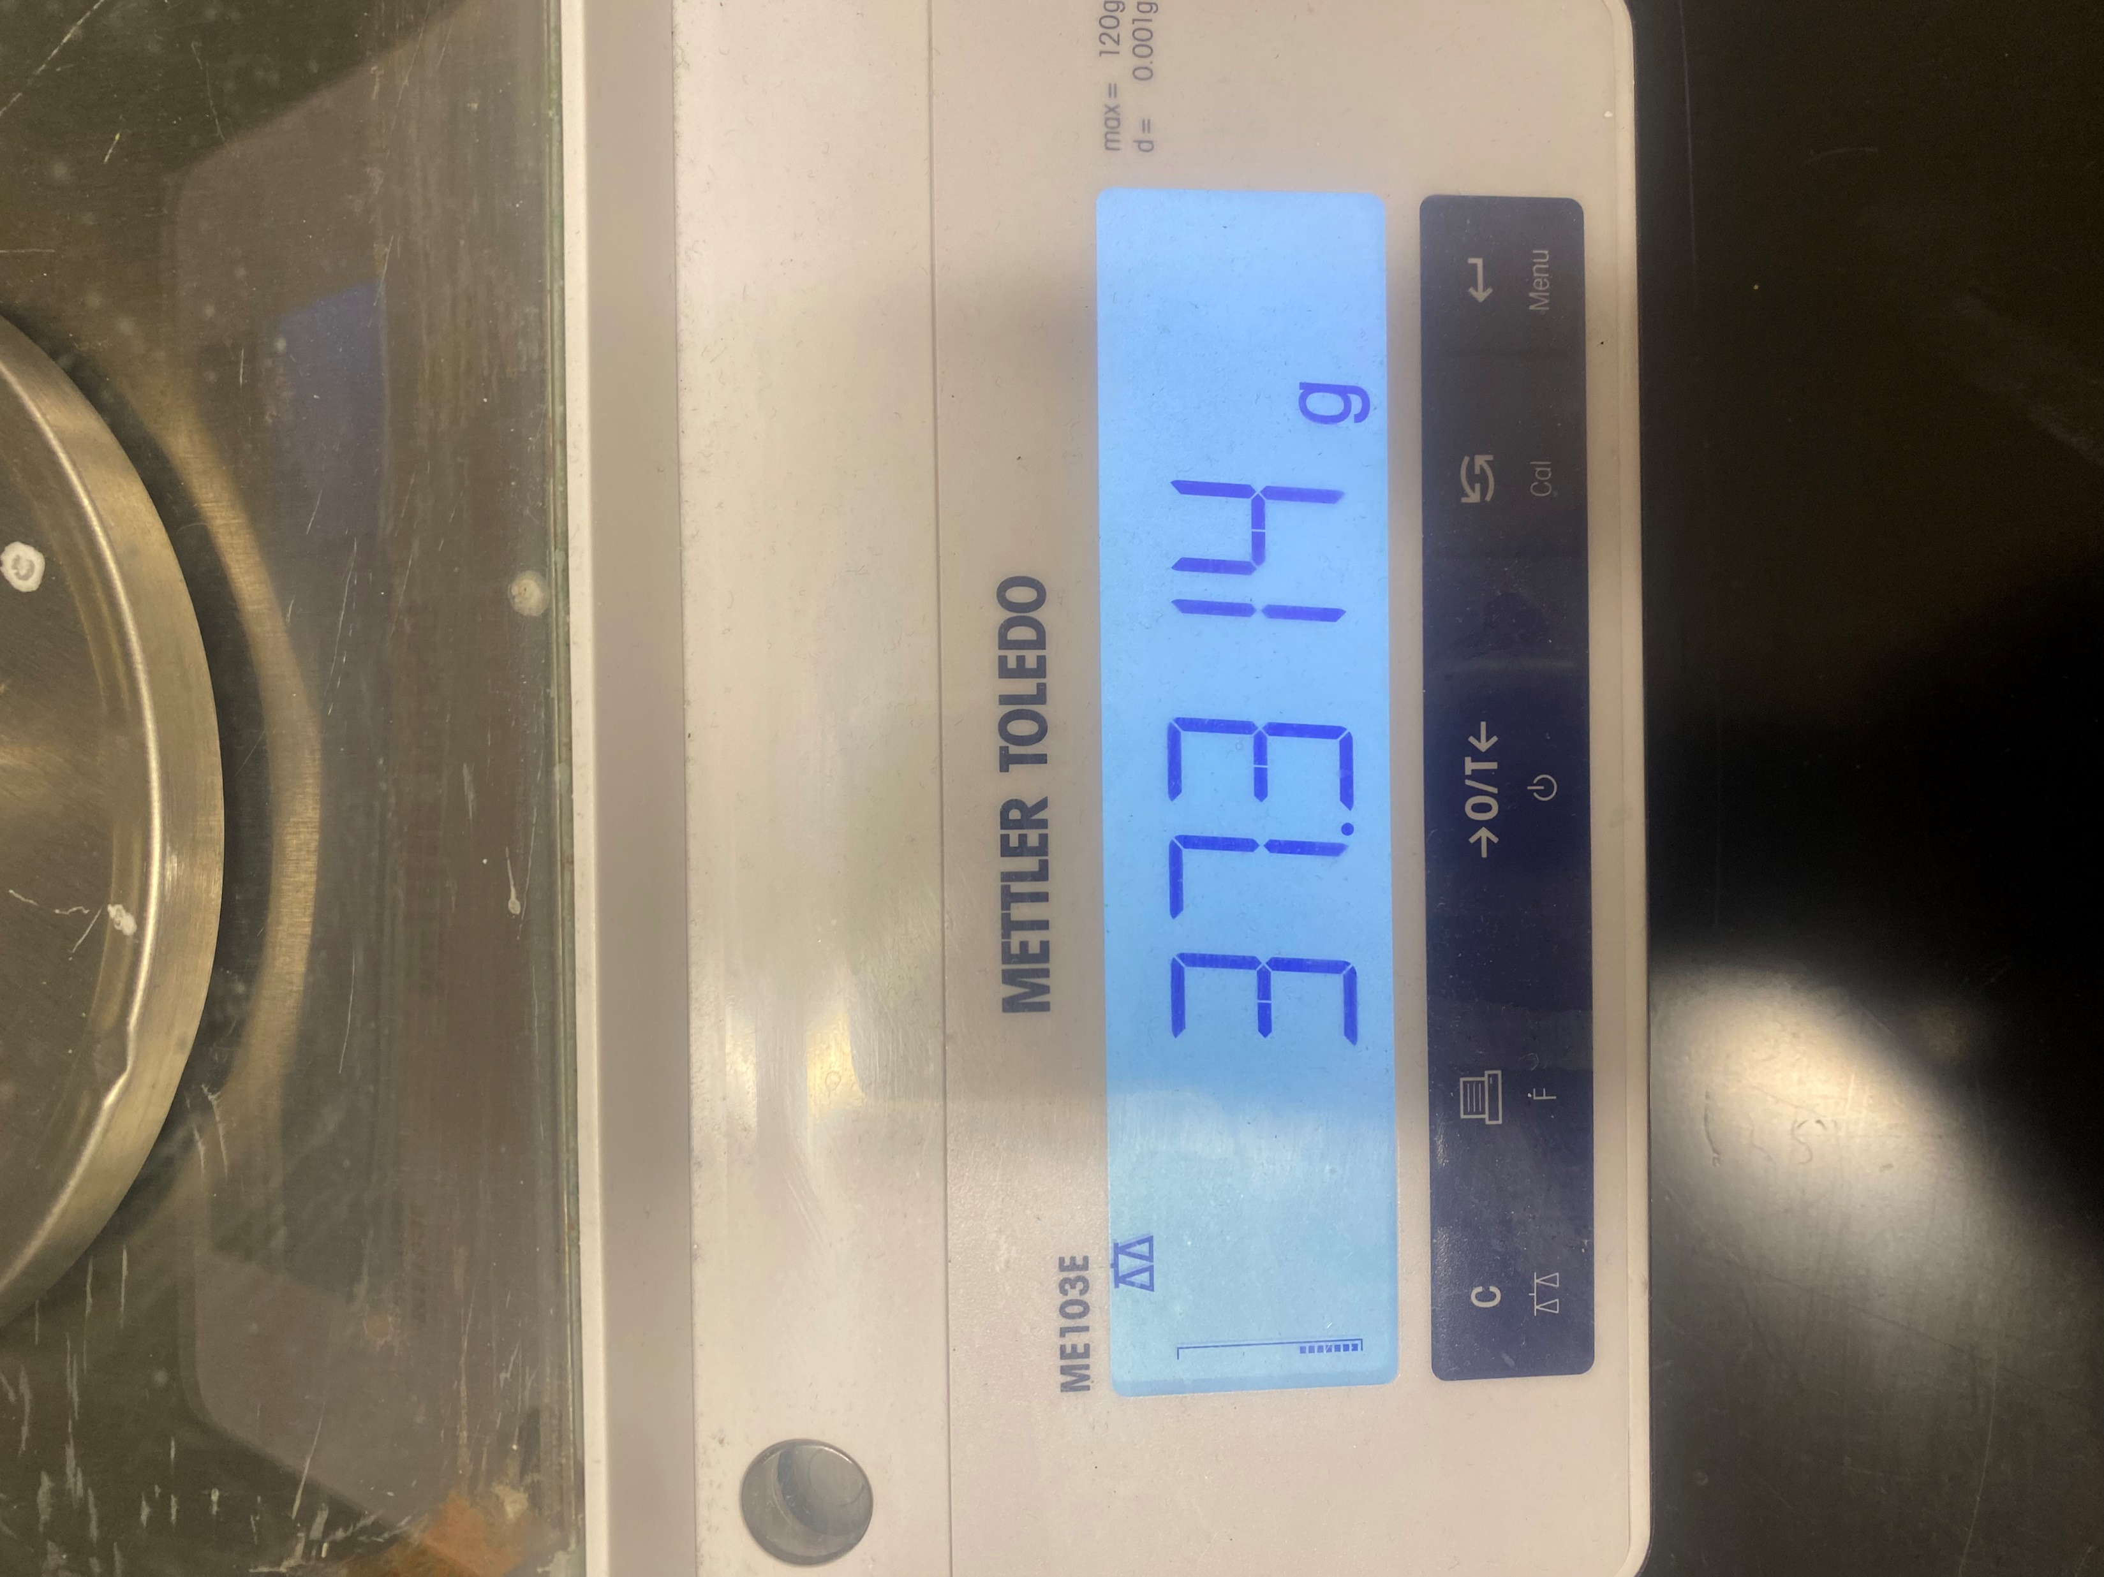
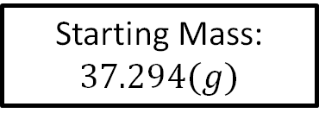
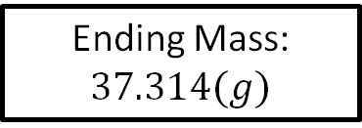
Material Storage
Starting Mass: $37.294(g)$
Ran the electrolyzer for 30 minutes.
Ending Mass: $37.314(g)$
$37.314\left(g\right)−37.294\left(g\right)=0.020(g)$ of hydrogen stored
Notes:
Hannah

Slide 37

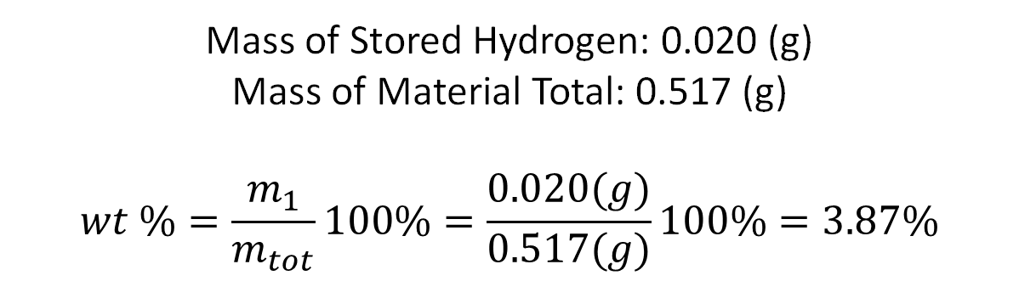
Material Capacity
Mass of Stored Hydrogen: 0.020 (g)
Mass of Material Total: 0.517 (g)
$$wt \%=\frac{m_{1}}{m_{tot}}100\%=\frac{0.020(g)}{0.517(g)}100\%=3.87\%$$
Requirement 4.4
“The storage material must have a minimum hydrogen density of 2 wt%.”
TEST INCOMPLETE
Notes:
Hannah
Estimated amount of hydrogen needed

Slide 38

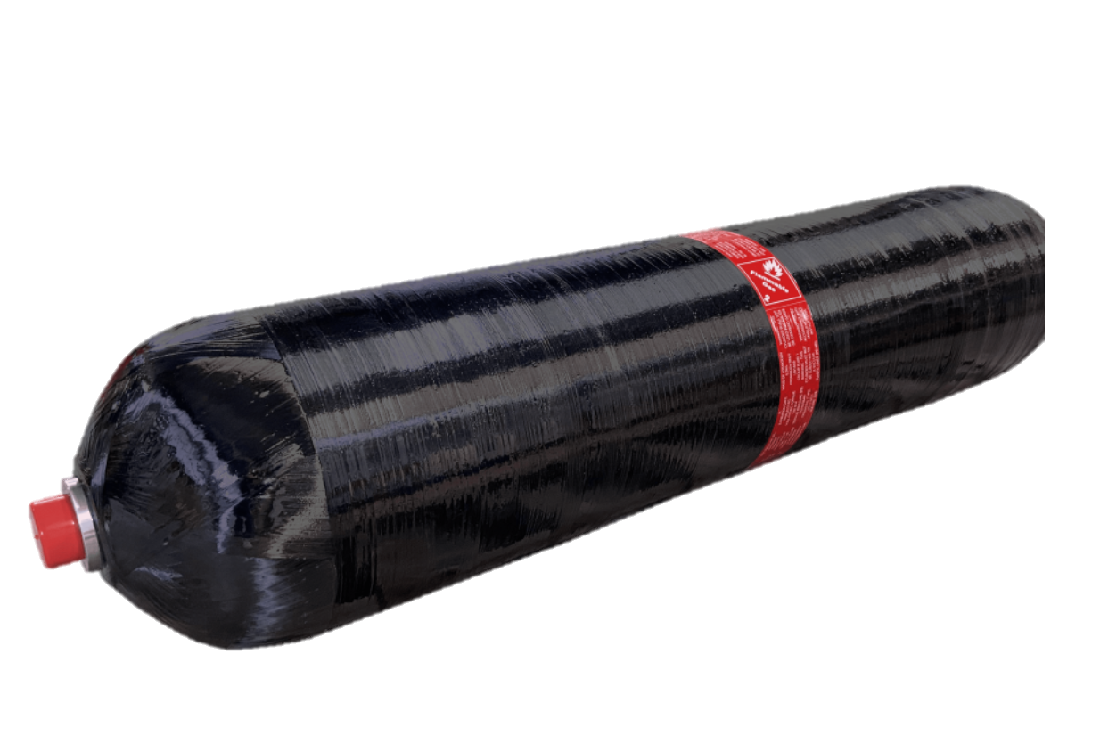
Material Storage Benefits
 | Compressed Storage | Material Storage
Energy Density | 592.9-3796 J/m | 140-280 J/m^3
Weight Percentage | 3.53% | 3.87%
Storage Pressure | 60-500 bar | 1 bar
Notes:
Hannah

Slide 39
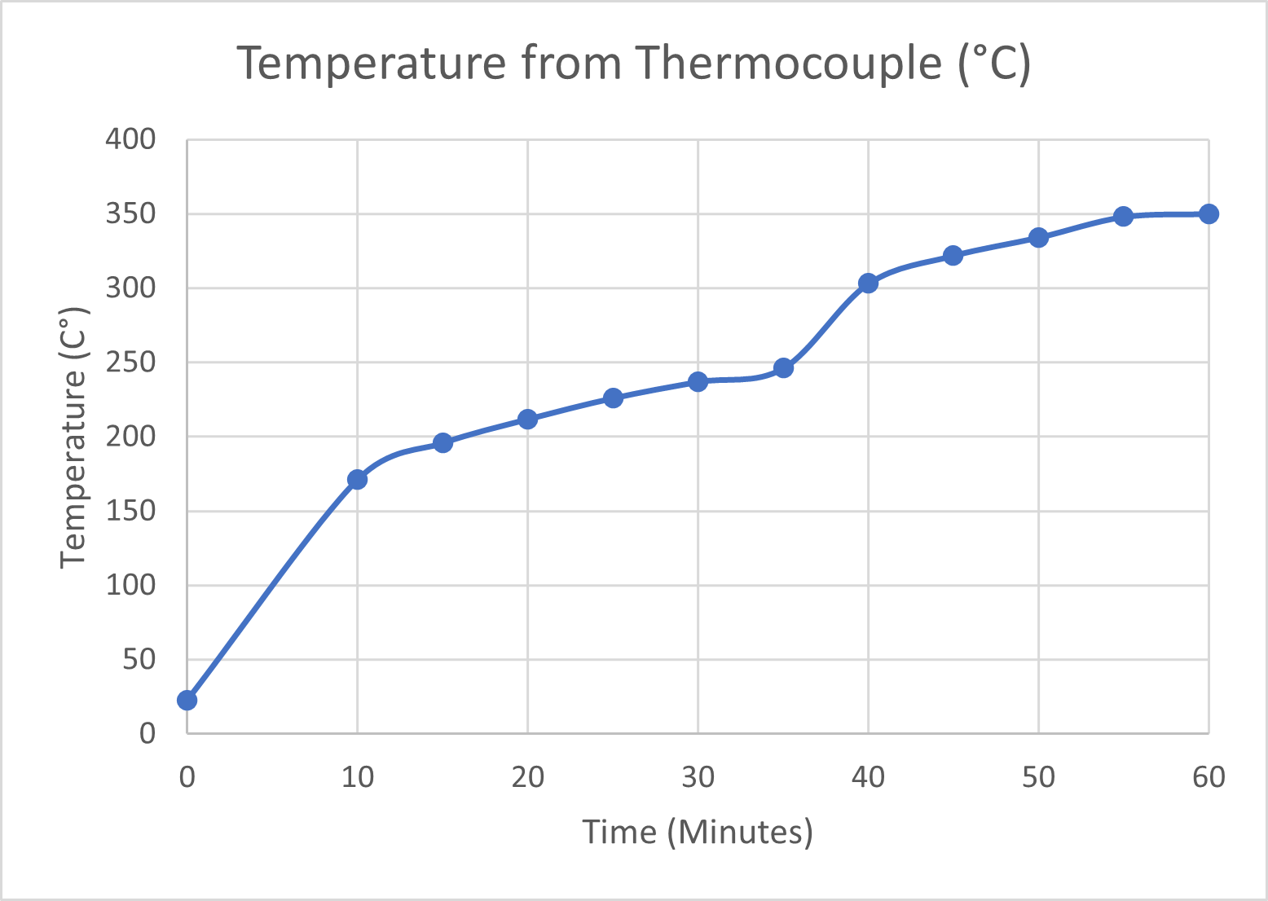
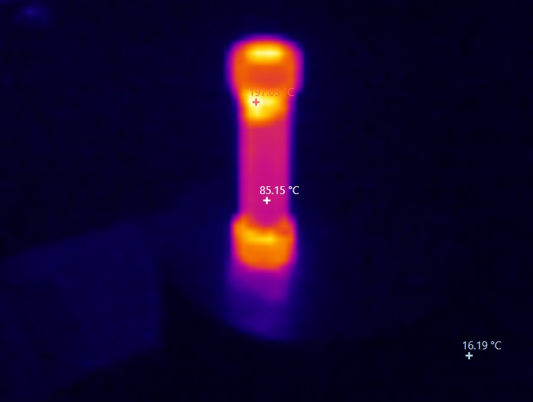
System Heating
Requirement 4.1
“The storage material must be heated to 300°C and not exceed 350°C.”
TEST INCOMPLETE
Max Temperature (200°C)
Applied Power
300°C Minimum
Power: 16.77W
350°C Minimum
Power: 23.56W
Notes:
Tesla

Slide 40



Thermal Survivability
Requirement 5.2
“The system must withstand temperatures up to 350°C.”
Silica Sleeve
Resistant to 1260 °C
Aluminum Silicate Fiber
Resistant to 815 °C
Nichrome Wire Lead
Notes:
Tesla

Slide 41
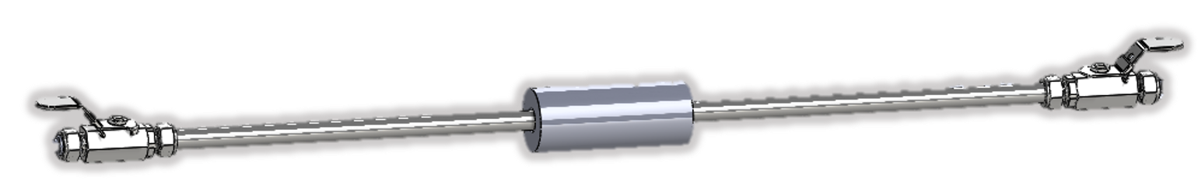
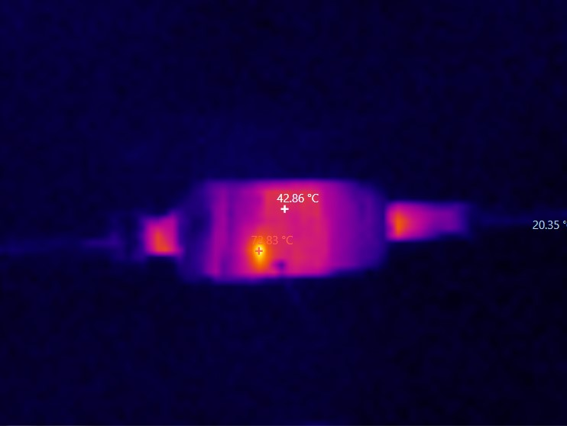
Pipe Heat Transfer
Worst-case scenario analysis:
350°C
50°C
50°C
6 in
6 in
Worst-case scenario testing:
350°C
Room Temperature (20°C)
Requirement 5.3
“The temperature at the valves must not exceed 50°C.”
Notes:
Jacob Wolf

Slide 42

Notes:
Dylan

Slide 43
Limiting Factors
Notes:
Jacob

Slide 44
“Murphy always gets a vote.”
- Dr. Michael Fabian
Notes:
Jacob

Slide 45
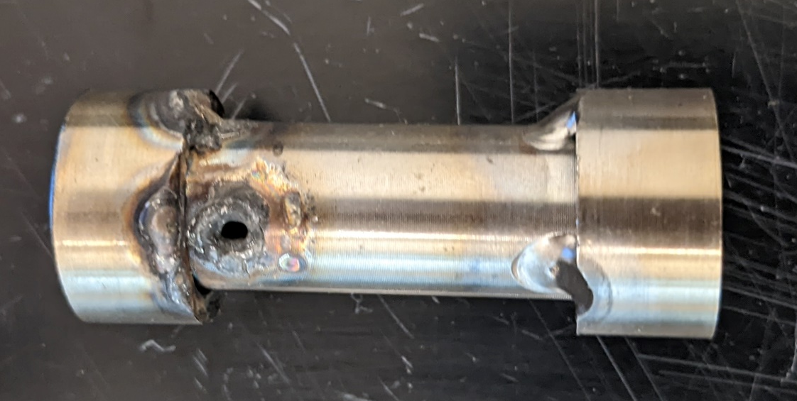
Blown-up Material Storage Capsule
Notes:
Tesla

Slide 46
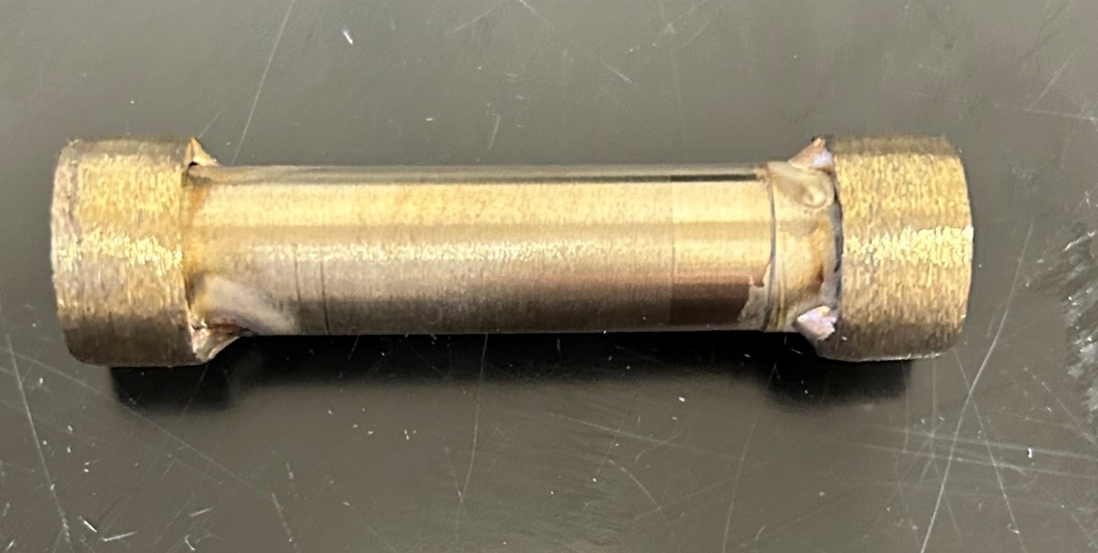
New Material Storage Capsule
Notes:
Tesla

Slide 47
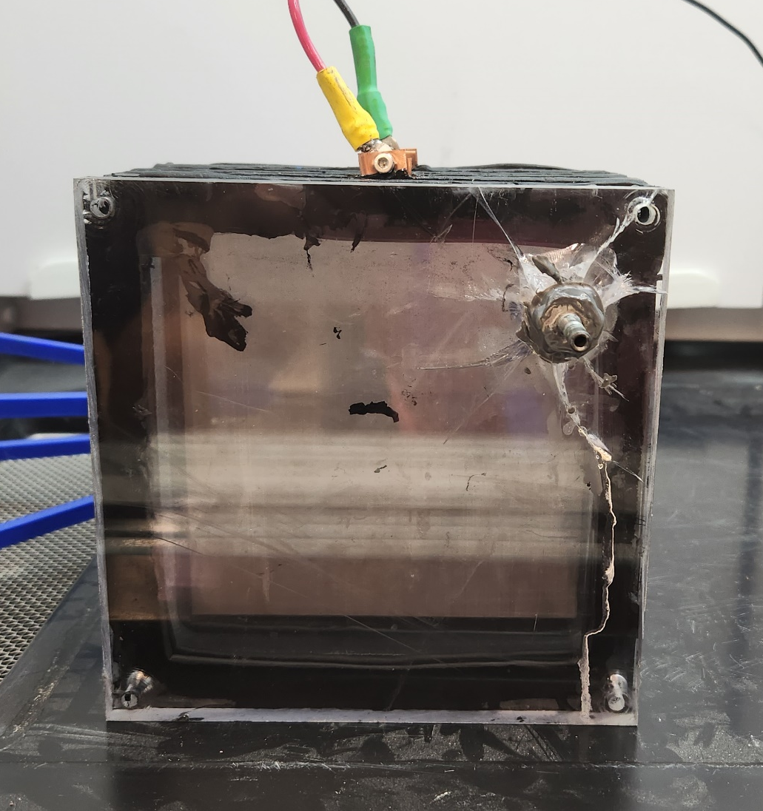
Cracked Electrolyzer
Greatest chemical attack occurs at stress concentrations.
Notes:
Jacob

Slide 48
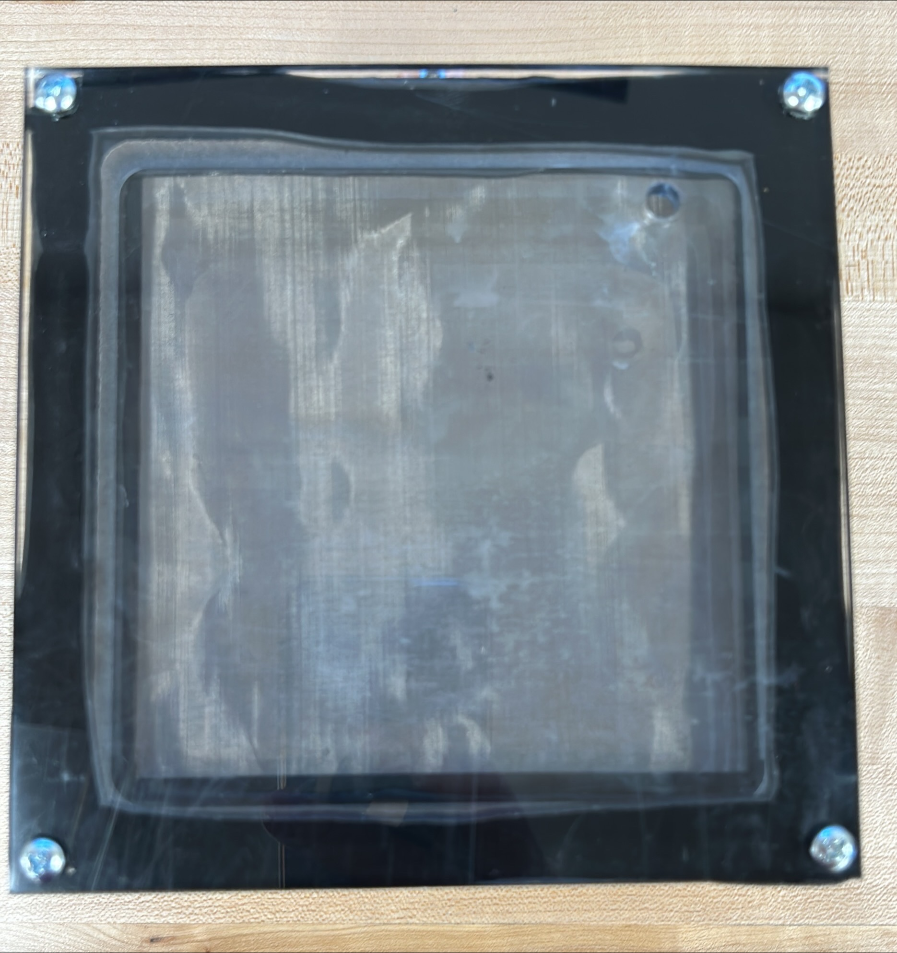
New Electrolyzer End Panels
Notes:
Jacob

Slide 49
Future Recommendations
Notes:
Jacob

Slide 50
Improve Heat Transfer to Capsule
Notes:
Hannah

Slide 51
Shorten Pipe
Cut & Reflare
Notes:
Jacob

Slide 52
Prevent Hydrogen Leakage
Potential Problem Spots
Notes:
Titan

Slide 53
Future Tests
Capacity Tests
Release Tests
To be performed next Monday
Notes:
Hannah

Slide 54

Questions?

Slide 55
References
[1] A. Murali, M. Sakar, S. Priya, R. J. Bensingh, and M. A. Kader, “Graphitic-Carbon Nitride for Hydrogen Storage,” in Nanoscale Graphitic Carbon Nitride, Elsevier, 2022, pp. 487–514. doi: 10.1016/B978-0-12-823034-3.00017-0.
[2] “Fast leakage test,” Unitem Wrocław, 28-Apr-2022. [Online]. Available: https://unitemmachines.com/our-offer/fast-leakage-test/. [Accessed: 08-Dec-2022].
[3] “Remington Industries.” [Online]. Available: https://www.remingtonindustries.com/
[4] “McMaster-Carr.” [Online]. Available: https://www.mcmaster.com/
[5] https://www.scielo.br/j/qn/a/KyQvF9DMHK6ZJXyL5zQNy7N/?lang=en&format=pdf
[6] https://www.gichemicals.ie/Potassium-hydroxide.html#:~:text=Potassium%20Hydroxide%20is%20manufactured%20using,concentrated%20to%2050%25%20using%20evaporation.
[7]“Aluminum silicate fiber felt and board,” Aluminum Silicate Fiber Felt and Board. [Online]. Available: https://www.samaterials.com/ceramic-material/2515-aluminum-silicate-fiber-felt-and-board.html. [Accessed: 21-Feb-2023].
[8] Heat Transfer Textbook

Slide 56
Additional Slides
Requirements
Generation
Natural Gas
Photobiological
Microbial Biomass conversion
Storage
Physical
Material
Equations
Graphic Design
Schedule
Ideal Gas

Slide 57
Generation - Natural Gas
Methane Resource
Methane is collected from a source (usually from natural gas)
Steam-Methane Reforming
High temperature steam (at 700-1,000 °C) is added to the methane gas
Hydrogen Extraction
Hydrogen gas is extracted from the steam-methane mix from an added catalyst
Notes:
The common catalyst used for steam-methane is typically nickel but research has been done showing that the noble metals can also work. This process produces hydrogen gas, carbon monoxide, and a small amount of carbon dioxide. DOE did not specify how much CO2 was produced.

Slide 58
Generation - Photobiological
Bacteria Strain
Water is Supplied
Bacteria Uses Photosynthesis
Water is Broken Down into its Elemental Form
Hydrogen Gas is Released
Notes:
After a complete cycle, the bacteria will need some amount of filtration provided, before adding more water. This filtration will remove all nitrates and acidic biproduct chemicals that was produced during a full cycle. During this process the bacteria will consume a percentage of the hydrogen gas, making the gas production rates and net efficiency of the system low.

Slide 59
Generation - Microbial Biomass Conversion
Bacteria Strain
Hydrocarbon is Added
Bacteria Uses Fermentation
After Fermentation, the Bacteria Leaves Behind Several Elements
Hydrogen Gas can be Filtered Out.

Slide 60
Storage – Physical Storage
Compressed
5,000-10,000 PSI
Unique Pressure Vessels
Cryogenic
Liquid H2 at -252.2 °C
Solid H2 at -259.14°C

Slide 61
Storage – Material Storage
Adsorbtion
Hydrogen is Stuck to the Compound’s Surface
Absorption
Hydrogen is Encased by the Compound

Slide 62
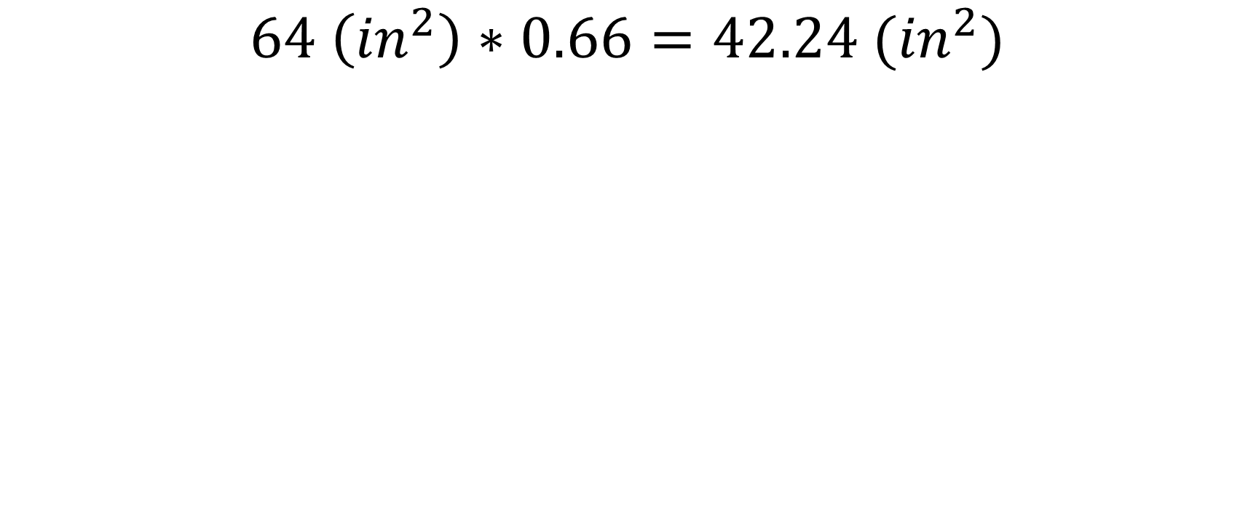
Equations – Area of Mesh
$$64 \left({in}^{2}\right)∗0.66=42.24 ({in}^{2})$$

Slide 63
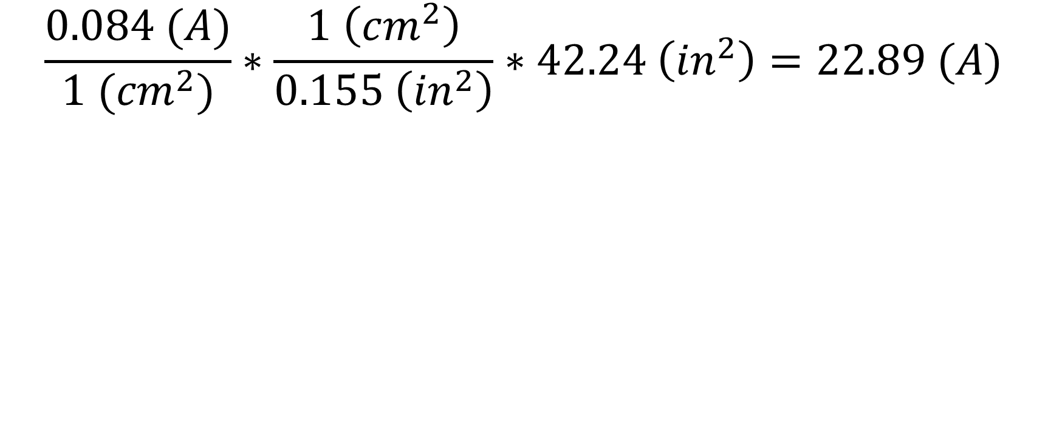
Equations – Max Current
$$\frac{0.084 (A)}{1 ({cm}^{2})}∗\frac{1 \left({cm}^{2}\right)}{0.155 \left({in}^{2}\right)}∗42.24 \left({in}^{2}\right)=22.89 (A)$$

Slide 64
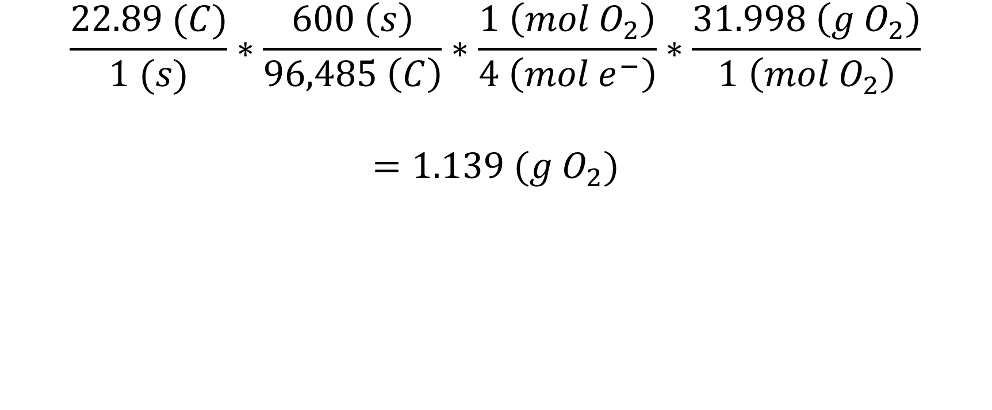
Equations – Rate of O2 Production
$$\frac{22.89 (C)}{1 (s)}∗\frac{600 \left(s\right)}{96,485 \left(C\right)}∗\frac{1 \left(mol O_{2}\right)}{4 \left(mol e^{−}\right)}∗\frac{31.998 \left(g O_{2}\right)}{1 \left(mol O_{2}\right)}$$
$$=1.139 (g O_{2})$$

Slide 65

Schedule of Project
Date tracking Gantt ERH2 (version 1).xlsb.xlsx

Slide 66
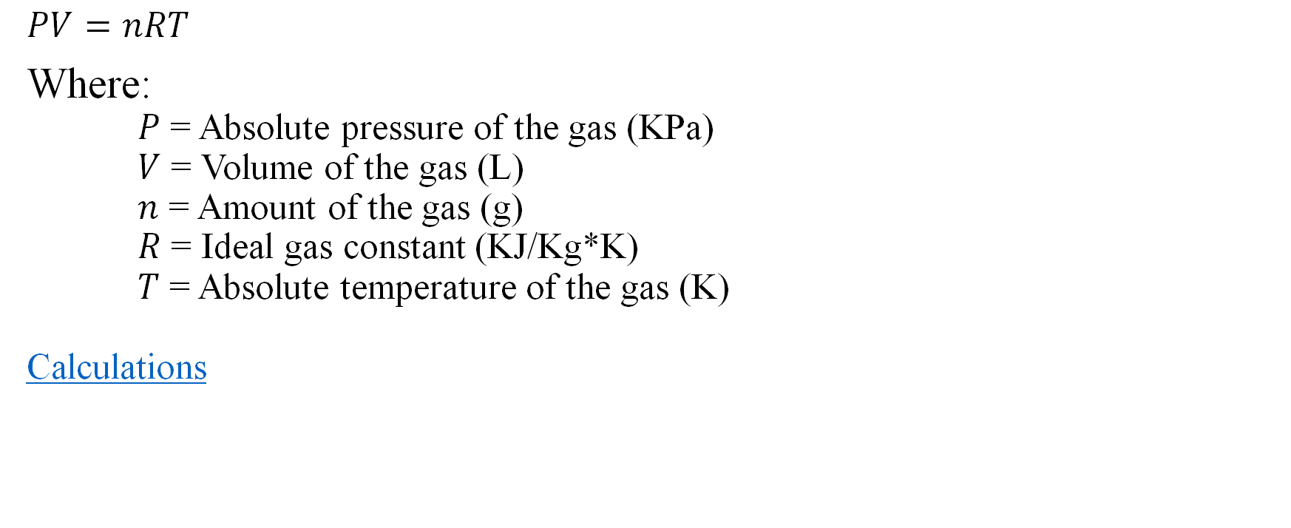
Ideal Gas Law
$PV=nRT$
Where:
$P$ = Absolute pressure of the gas (KPa)
$V$ = Volume of the gas (L)
$n$ = Amount of the gas (g)
$R$ = Ideal gas constant (KJ/Kg*K)
$T$ = Absolute temperature of the gas (K)
Calculations

Slide 67
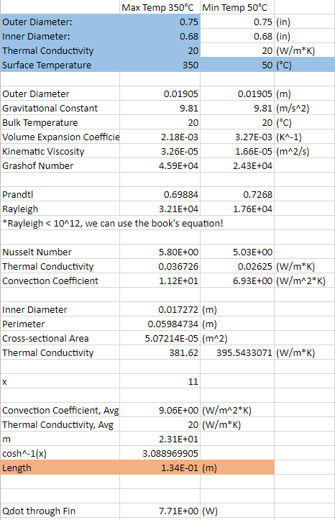
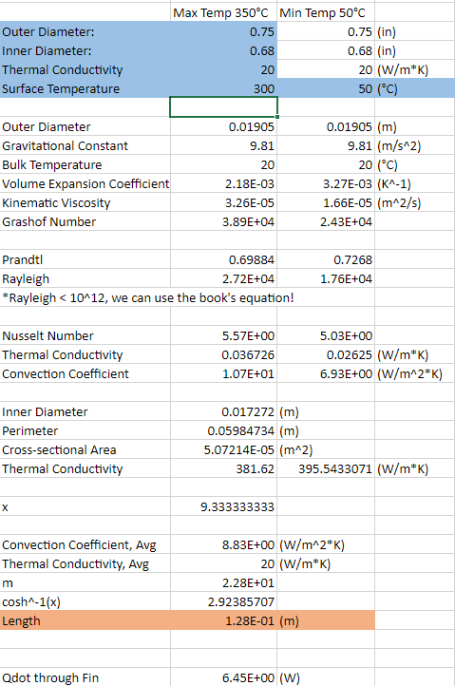
Heat Loss / Required Power

Slide 68

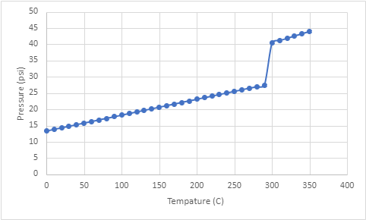

Vessel Pressure
Maximum Vessel Pressure: 40.43psia
Champagne Bottle: 90psia
Soda Can: 30psia

Slide 69
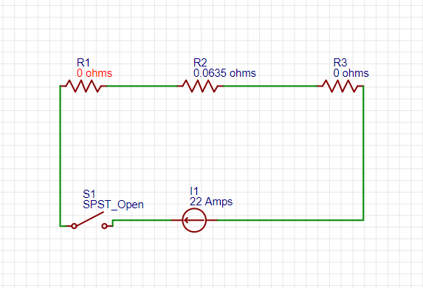
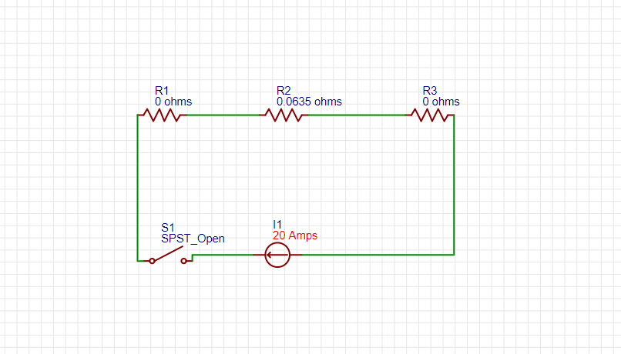
Electrolysis Power Circuit
R1 = R3
Nickel Mesh
R2
Salt Water
Notes:
Grant
Grant 1.25 in by resistance of saltwater 2 ohms per meter

Slide 70
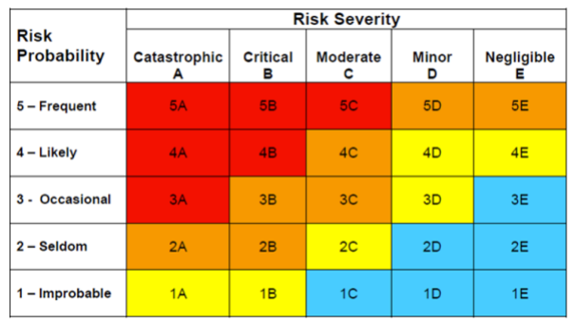
Risk Matrix – Before Mitigation
Notes:
Hannah

Slide 71

Pressure Requirement
Requirement 10.2
“-”
Atmospheric Pressure: 14.7psi absolute
Maximum Internal Pressure: 14.7 + 0.29 = 14.99psi absolute
Hard Copper Pipe
0.5”OD x 0.05”Wall Thickness x 2.63” Long
PTFE Tubing
0.31”OD x 0.03” Wall Thickness x 2’ Long
[3]

Slide 72
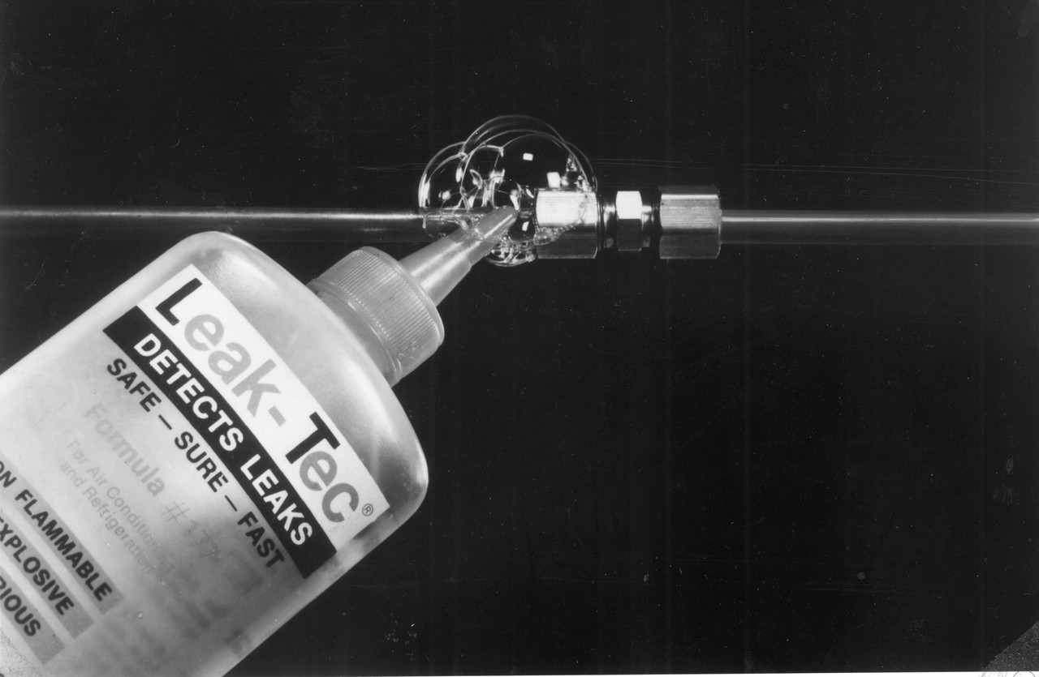
Detecting Leaks
ERH2 will follow ASHRAE Bubble Method under Chapter 29.9 Leak Detection in the 2017 edition ASHRAE Handbook.
[2]

